Slide 1

SMA PROJECT

Slide 2

Table of
CONTENTS
01
02
03
04
Downloading XMLs using Scopus API
XML Parsing and CSV Export for Image and Caption Extraction
Keyword Highlighting in Captions
Downloading and Storing Highlighted Images
05
06
07
08
Image Refinement and Transfer Based on Keyword Extraction
Seperating Refined Images
Extracting the X-Y Labels from the graphs
Future Plans
and Challenges

Slide 3

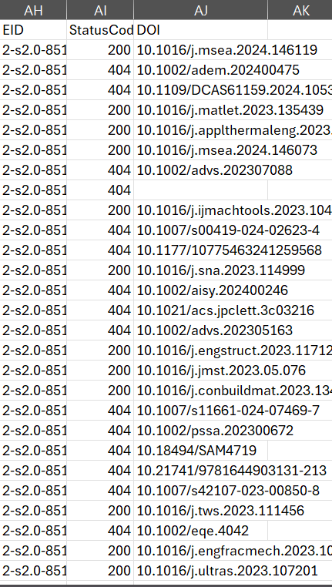
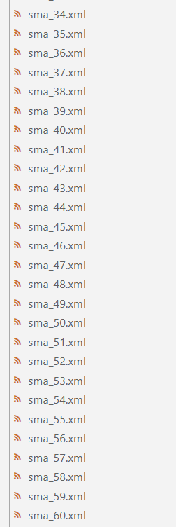
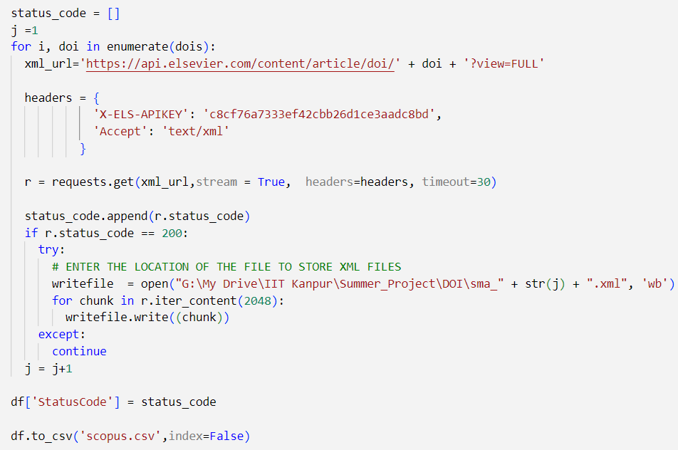
Downloading XMLs using APIs
Obtaining CSV from Scopus having paper DOIs
Getting XMLs using Scopus APIs

Slide 4
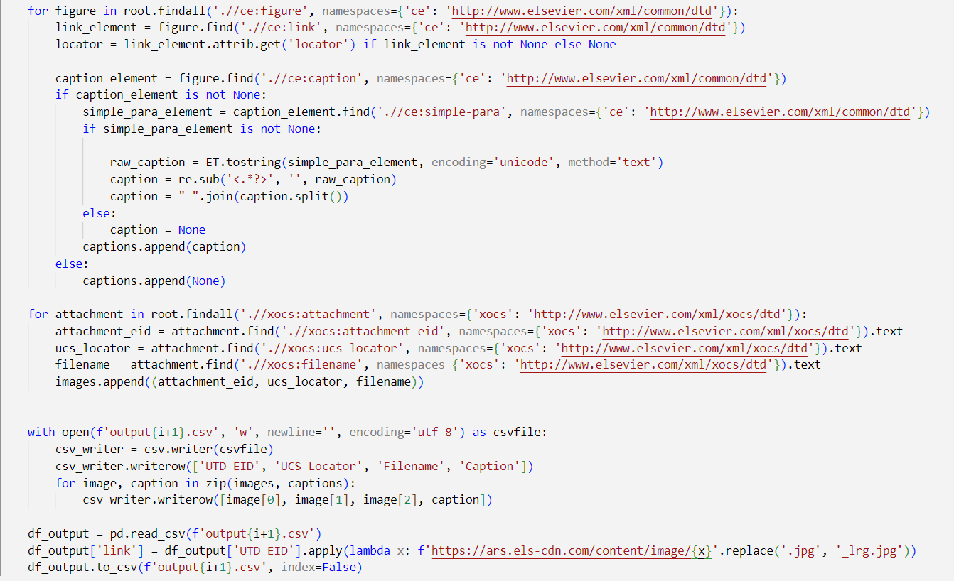
XML Parsing and CSV Export for Image and Caption Extraction
Extracting image locators, captions, and metadata.
Cleaning and processing the captions.
Writing the extracted data to CSV files.
Adding a column with constructed URLs for the images and saving the final CSV.

Slide 5
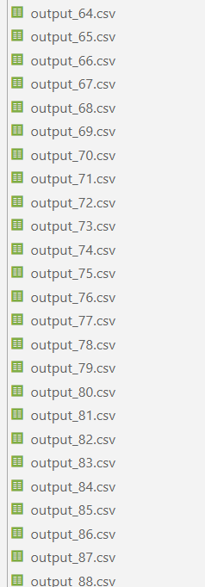
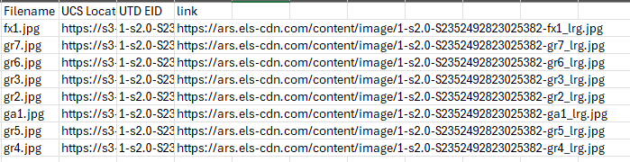
XML Parsing and CSV Export for Image and Caption Extraction

Slide 6
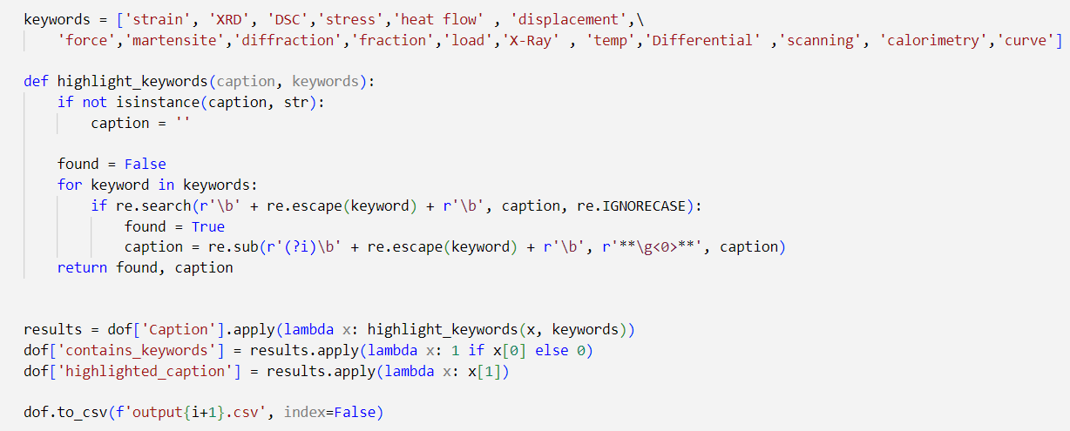
Keyword Highlighting in Captions
Defining a list of keywords to highlight in the captions.
Implementing a function to search for keywords in captions, highlight them if found.
Applying the keyword highlighting function to each caption.

Slide 7
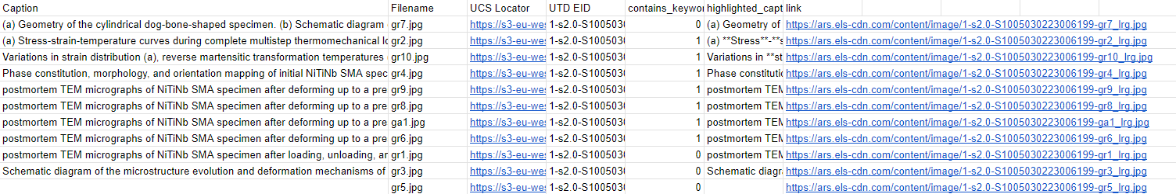
Keyword Highlighting in Captions
(A) **STRESS**-**STRAIN**-TEMPERATURE CURVES DURING COMPLETE MULTISTEP THERMOMECHANICAL LOADING PROCESS. (B) **STRESS**-**STRAIN** CURVES IN MECHANICAL LOADING AND UNLOADING PROCESSES. (C) **STRAIN**-TEMPERATURE CURVES IN HEATING PROCESS.

Slide 8
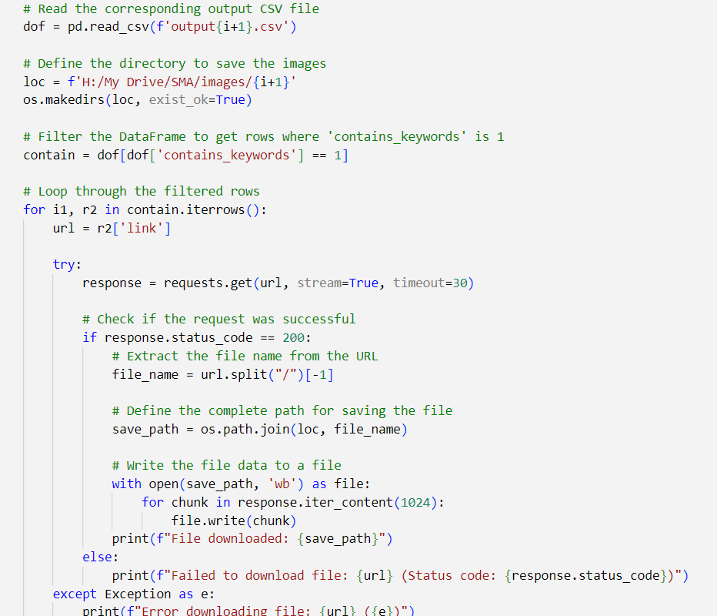
Downloading and Storing Highlighted Images
Creates a directory (loc) with index i+1 to save images.
Filters dof to include rows where contains_keywords is 1.
Iterates through contain DataFrame, extracting image URLs (link).
Attempts to download images using requests.get(); saves to save_path if successful (status_code is 200).
Implements error handling to manage exceptions during image download and provides error messages.

Slide 9
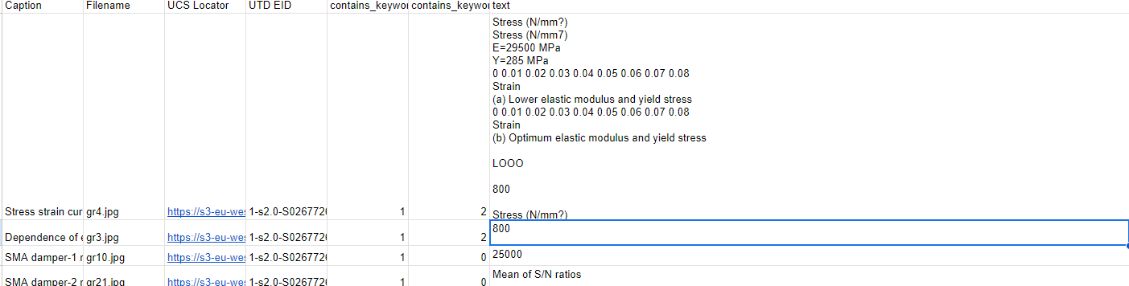
Image Refinement and Transfer Based on Keyword Extraction
Sets the Tesseract OCR executable path for text extraction from images.
Defines keywords for text highlighting in OCR results.
Implements a function to highlight keywords in text extracted from images using OCR.
Processes images by enhancing contrast, extracting text using Tesseract OCR, and highlighting keywords in the extracted text.
Manages image processing errors and logs messages for troubleshooting.

Slide 10
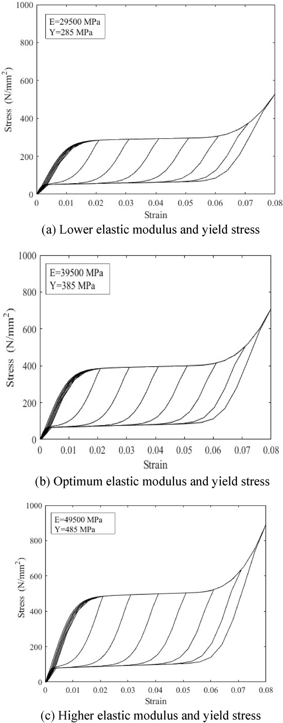
Image Refinement and Transfer Based on Keyword Extraction
STRESS (N/MM?)
STRESS (N/MM7)
E=29500 MPA
Y=285 MPA
0 0.01 0.02 0.03 0.04 0.05 0.06 0.07 0.08
STRAIN
(A) LOWER ELASTIC MODULUS AND YIELD STRESS
0 0.01 0.02 0.03 0.04 0.05 0.06 0.07 0.08
STRAIN
(B) OPTIMUM ELASTIC MODULUS AND YIELD STRESS
LOOO
800
STRESS (N/MM?)
200
0
0 0.01 0.02 0.03 O04 0.05 0.06 0.07 0.08
STRAIN
(C) HIGHER ELASTIC MODULUS AND YIELD STRESS

Slide 11
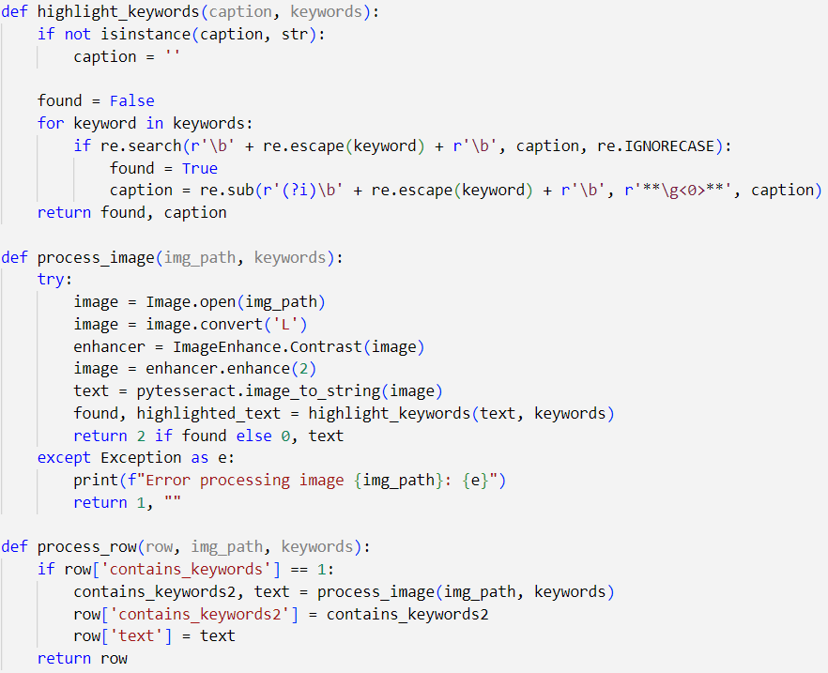
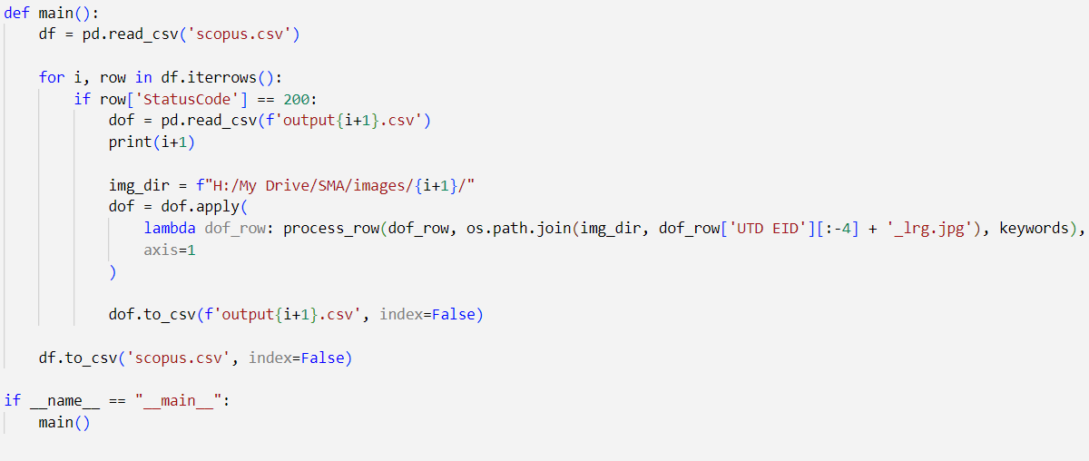
Image Refinement and Transfer Based on Keyword Extraction

Slide 12
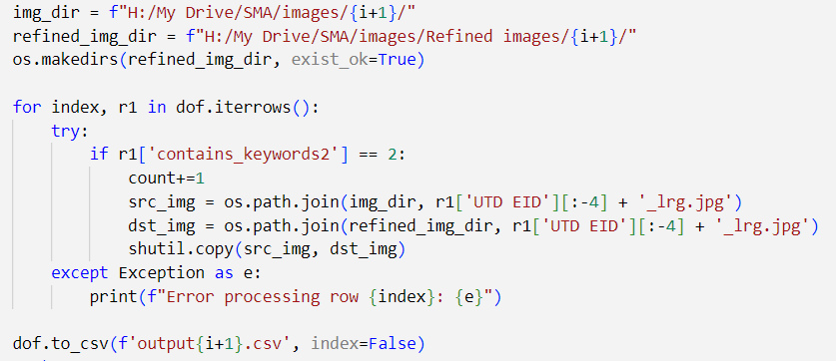
Seperating Refined Images
Total Images are 4909 and Level 1 are 1883 and Level 2 are 724

Slide 13
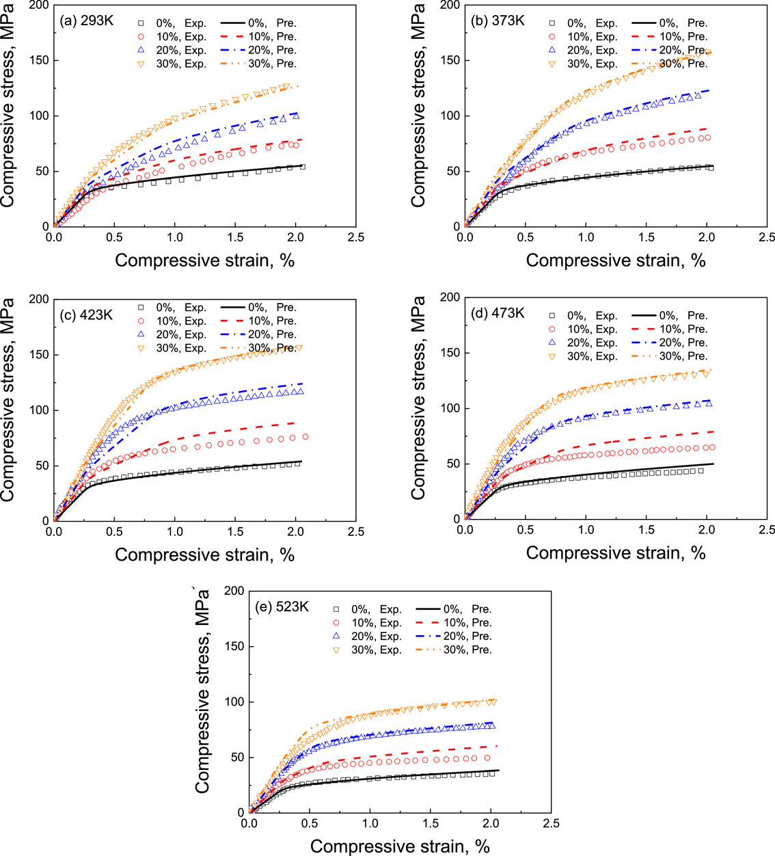
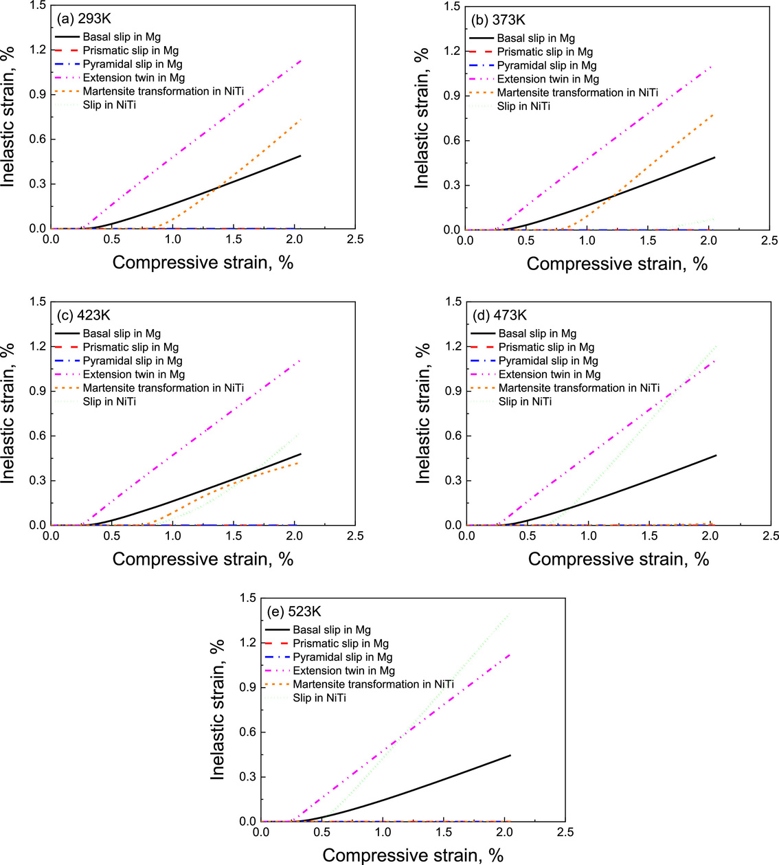
Seperating Refined Images

Slide 14
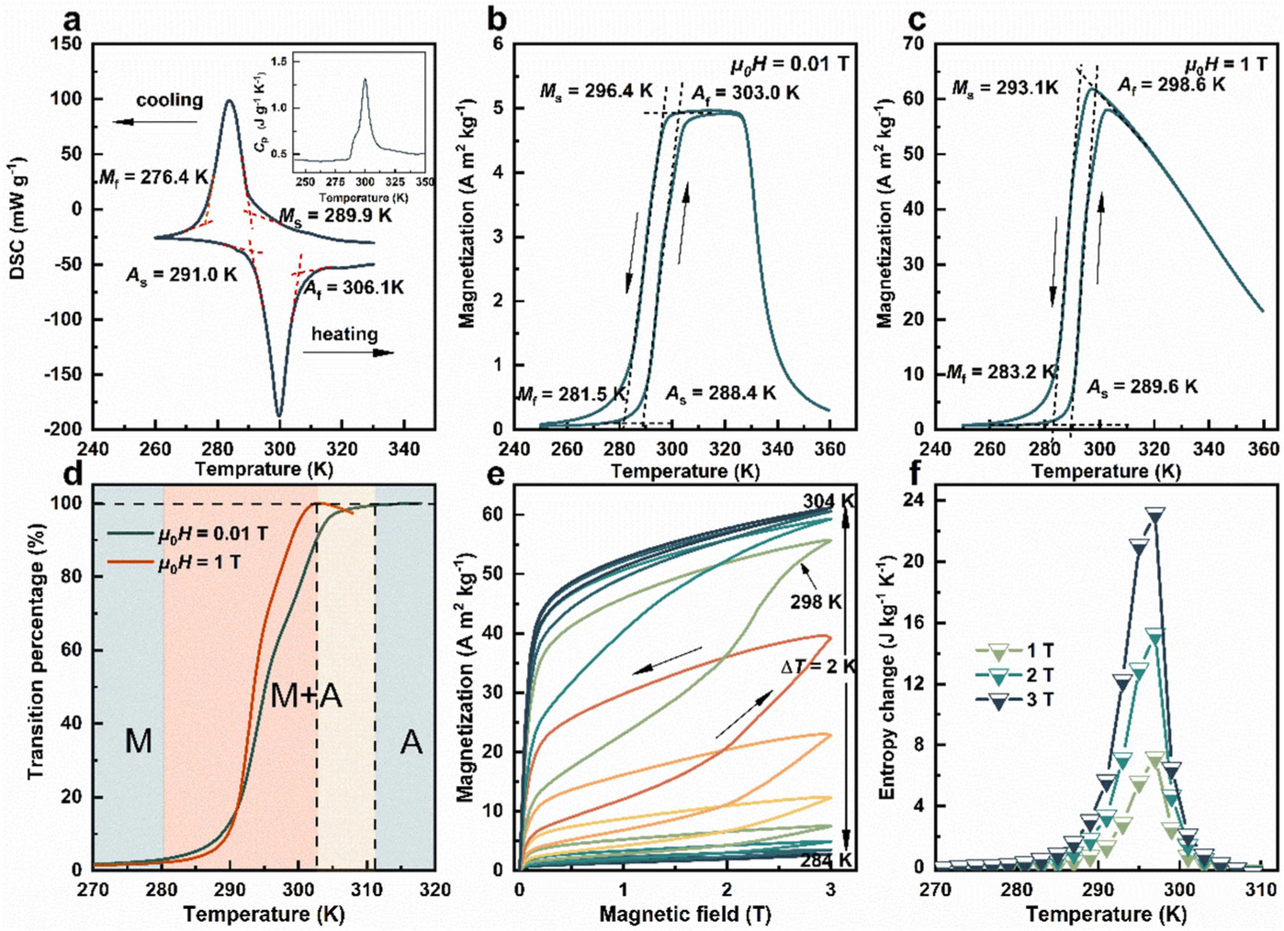
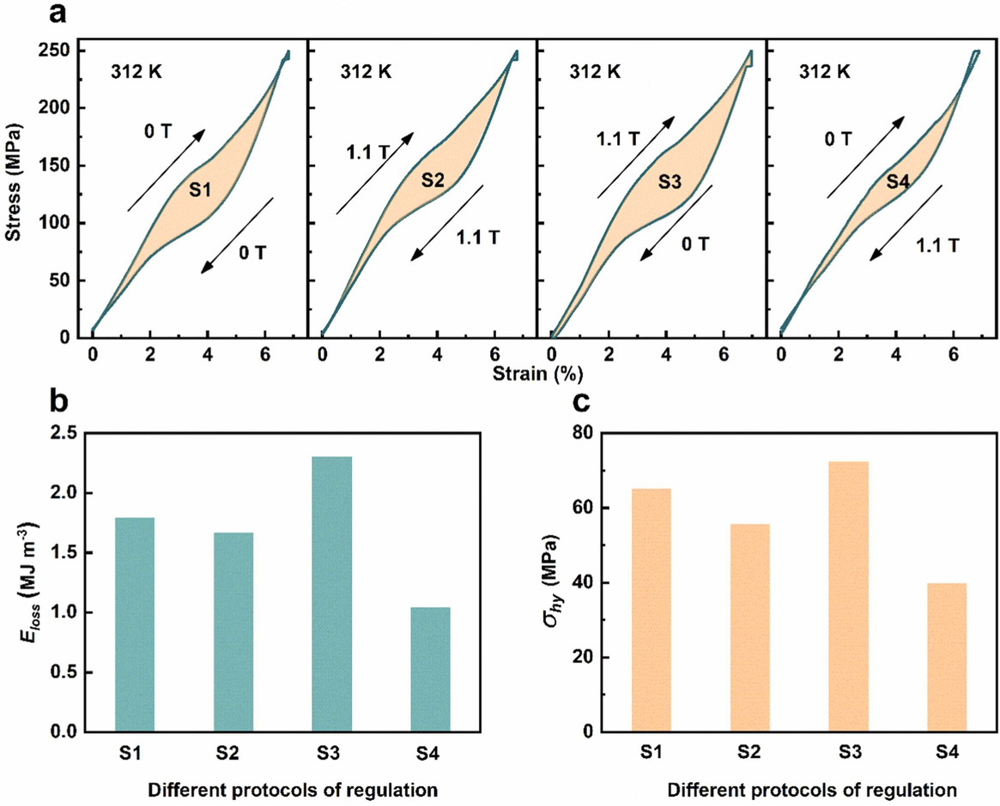
Seperating Refined Images

Slide 15
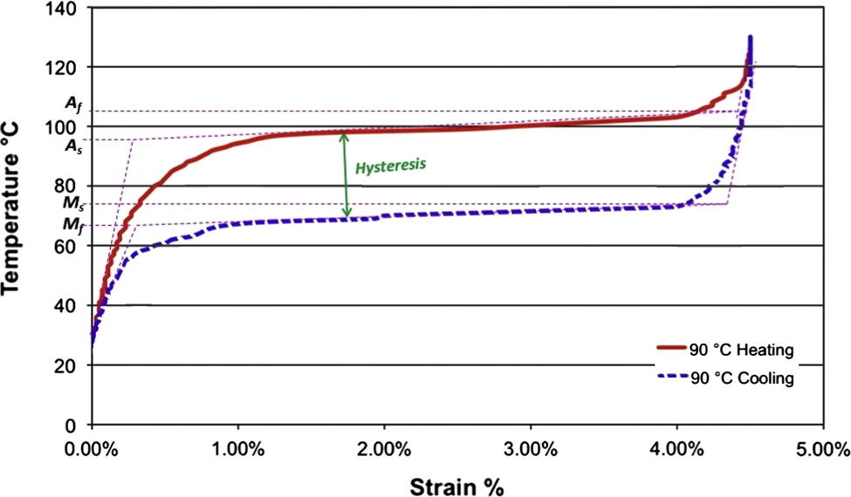
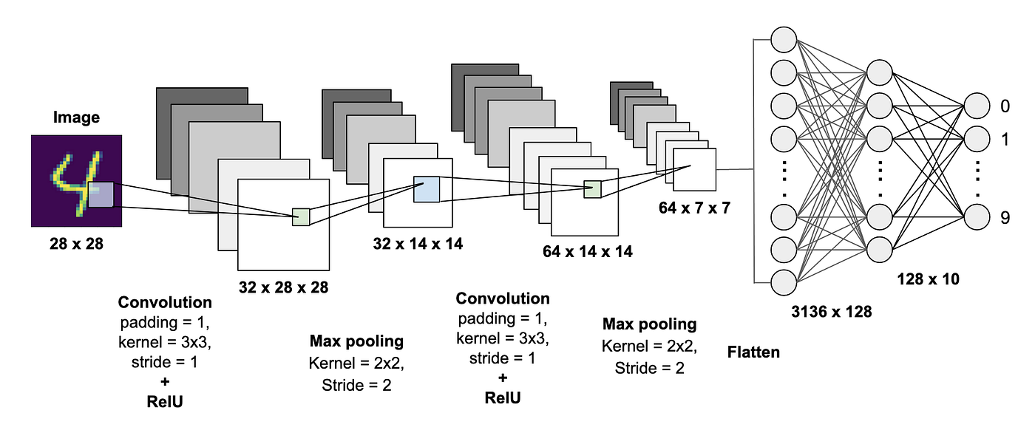
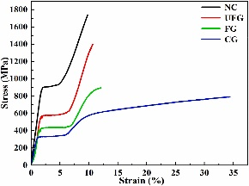
Further Refine the Images for the extraction of Data
Label a Data Set Containing images with Graph and train them on a Convolutional Neural Network Model.
CNN image classification model to classify images with graph which will further refine our data set.
It will help in obtaining the X-Y Label from the graphs
Sample Image

Slide 16
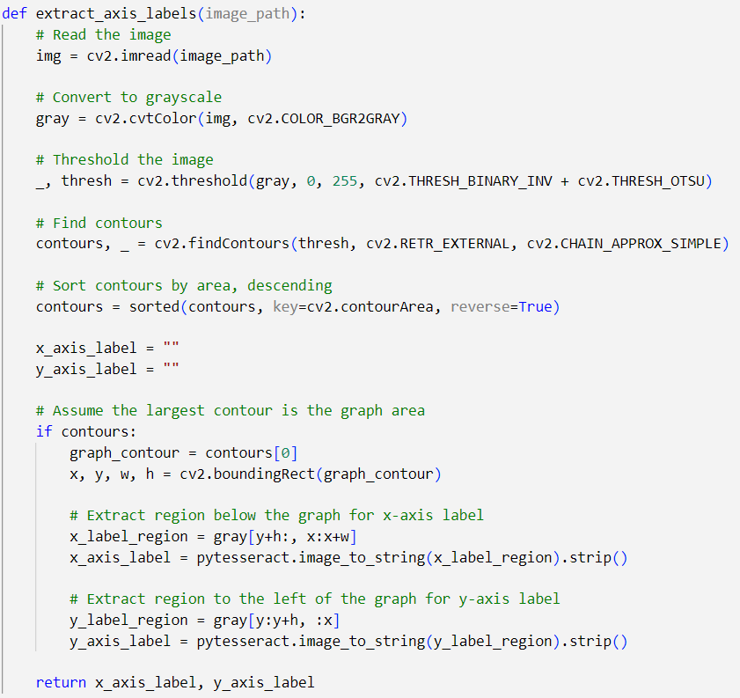
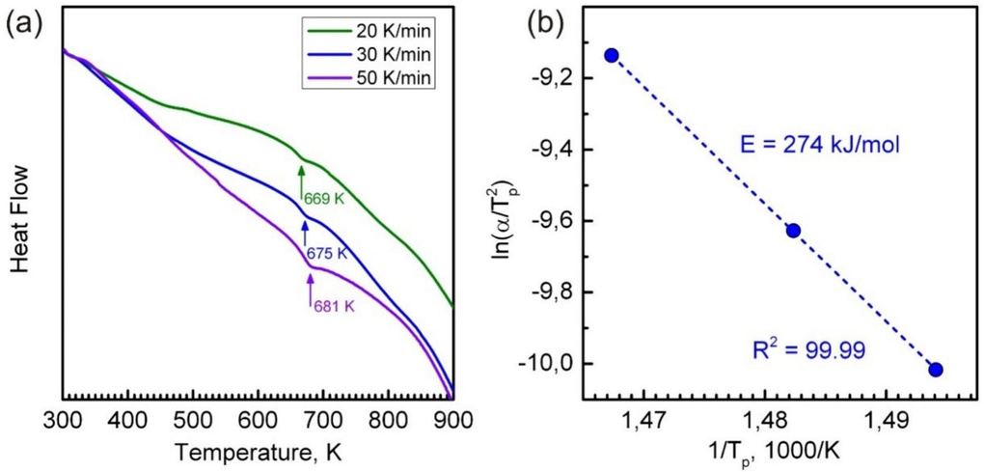
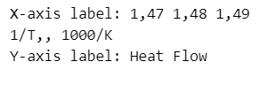
Identification of X-Y Labels Present in the Graph
INPUT IMAGE
FUNCTION OUTPUT

Slide 17
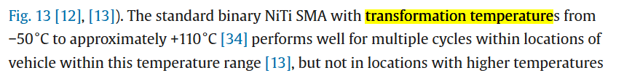
Future Plans & Challenges
Implement a model to obtain the data points from the graph . But it may not accurately predict the transition temperature.
Other option, to look out the value of Transition temperature in Research Article can be accessed by DOI mapped with image.
Implementation approach:
Search for the element composition in image or in caption and perform search operation in paper as with paragraph having keywords
Eg . “ temperature , NiTi“

Slide 18
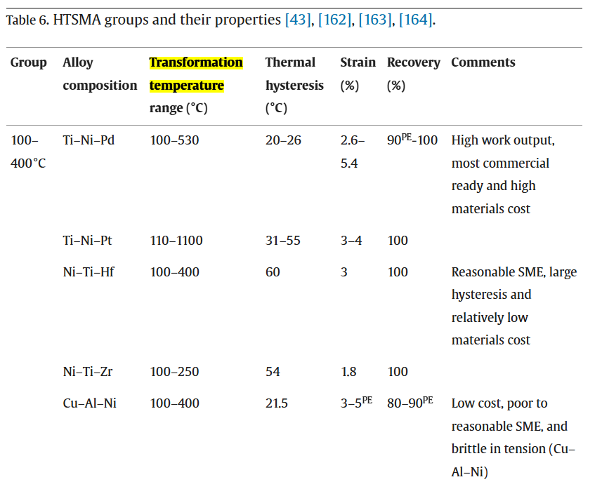
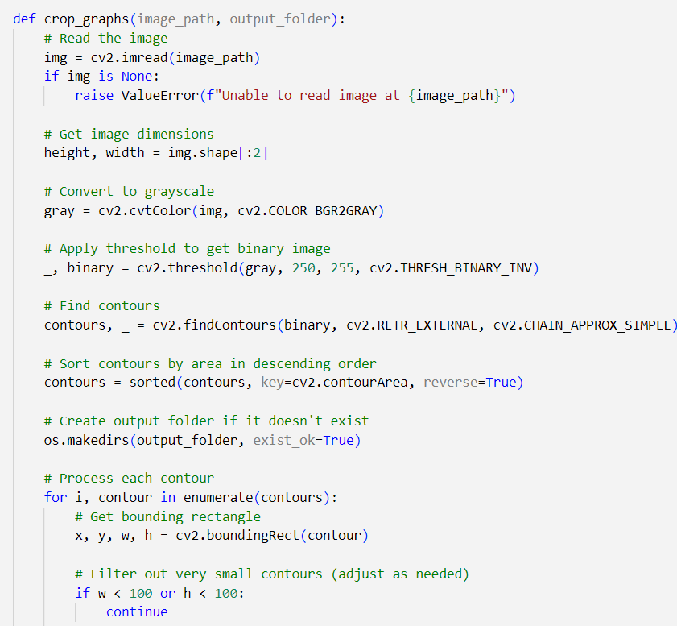
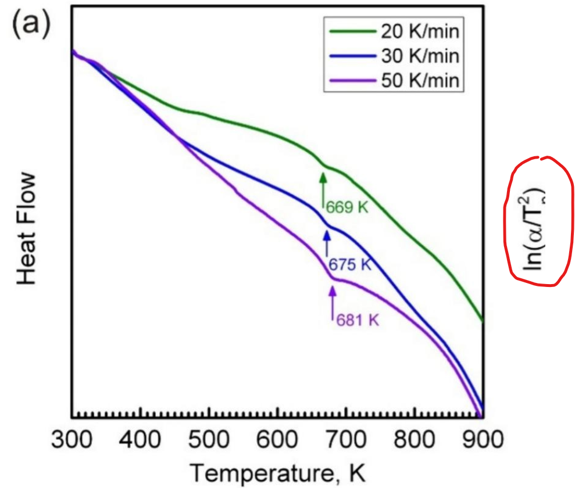
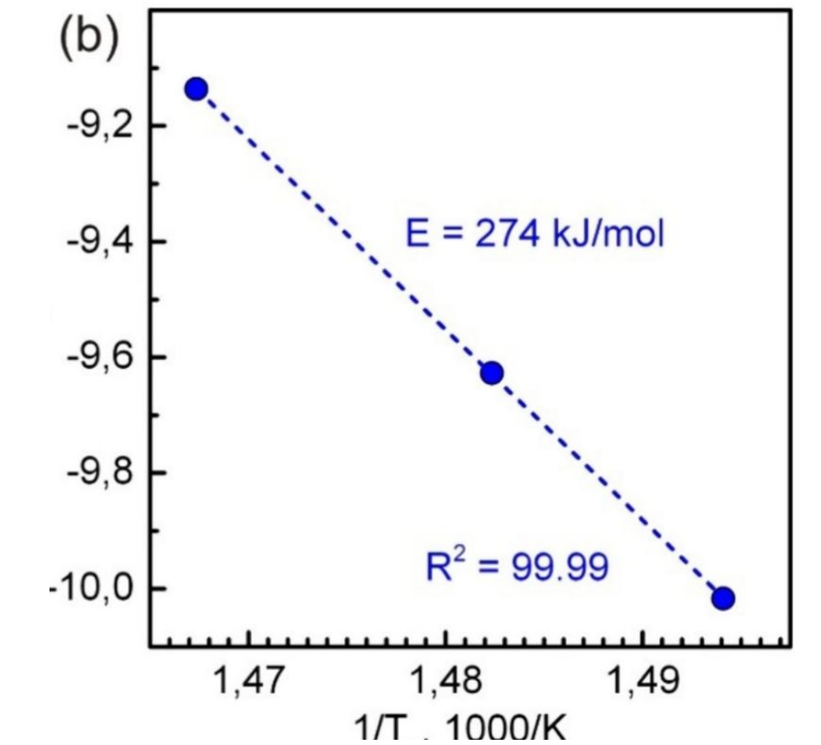
Challenges
Extraction of Data from the Tables in research papers
Dealing with images with multiple graphs Image cropping in bulk
Improper Splitting of images

Slide 19

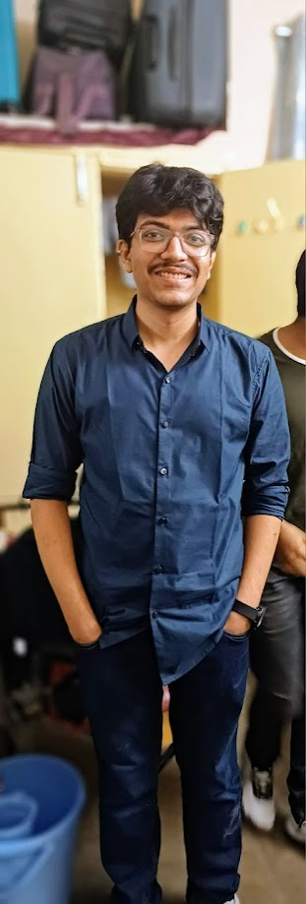

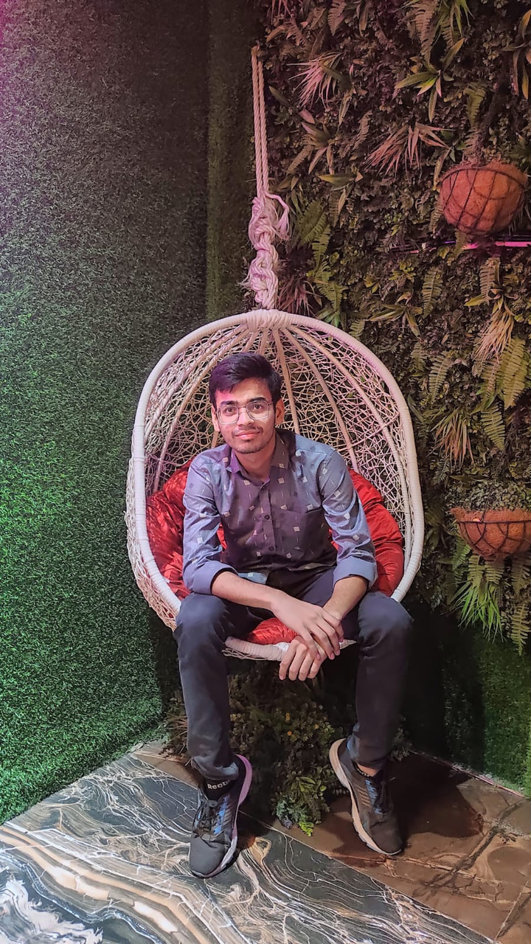
THE TEAM
Prathamesh Ladhe
Arvind Devkate
Aman Nigam

